Slide 1
Prototyping in HTML
Why, when, and how
GCdocs ID: 35735571

Slide 2
Agenda
Why and when prototype in HTML?
About the Web
About HTML (with exercises)
How we web at GC
Getting it online

Slide 3
Why and when prototype in HTML?

Slide 4
Existing prototyping tools
Dedicated tools include:
Adobe XD
Axure RP
Figma
Balsamiq
General-purpose tools include:
Miro
PowerPoint
Visio
Excel
paper

Slide 5
Advantages of prototyping in HTML
You’re working in the medium that the final product will be built in. This allows you to use paradigms that support that medium rather than paradigms that support a tool.
People can test the prototype right in their browser, using their familiar tools.
Including assistive technology like screen readers and screen magnifiers.
Responsive design is straightforward: you can create one interface that works at all window widths.
You can design how a page will be read by a screen reader.
You get WET for free.
You can start with existing pages and modify them.

Slide 6
Disadvantages of prototyping in HTML
Sometimes it’s overkill. If you’re changing text on a page, or adding a straightforward form field, then you don’t need to mock up the whole interface. Take a screenshot and make the changes in Paint.
Early in the design process when you’re still exploring the problem space, you should use the lightest-weight tool available so changes are as easy as possible.
If you’re prototyping complex interactions and you don’t want to mess around with JavaScript, it can be easier to use a dedicated tool.

Slide 7
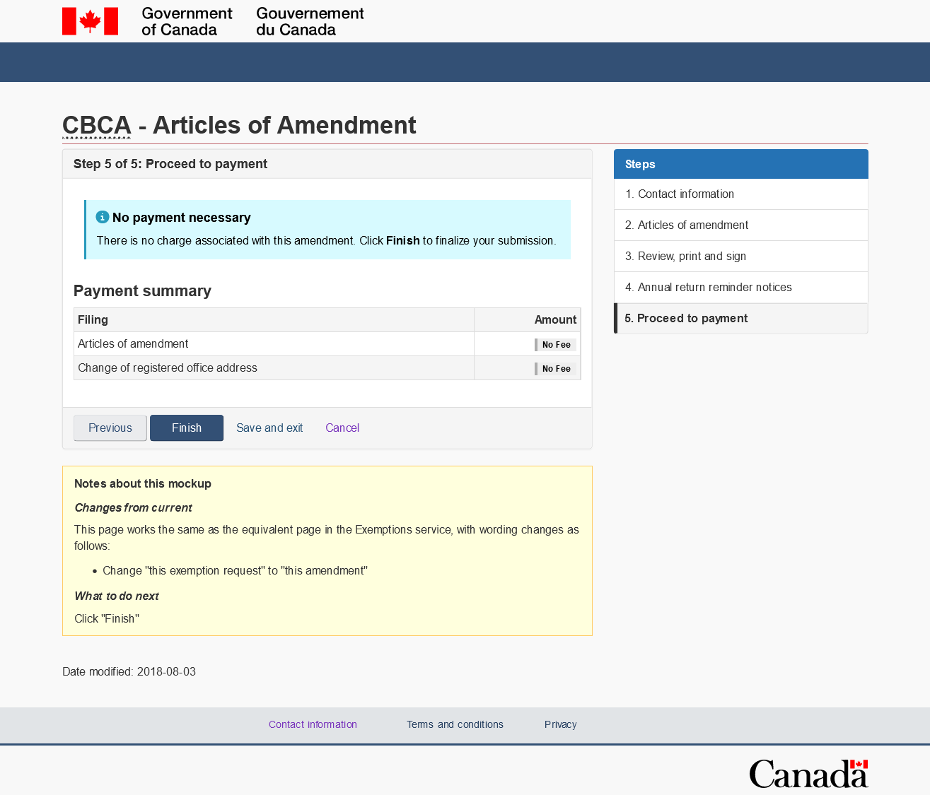
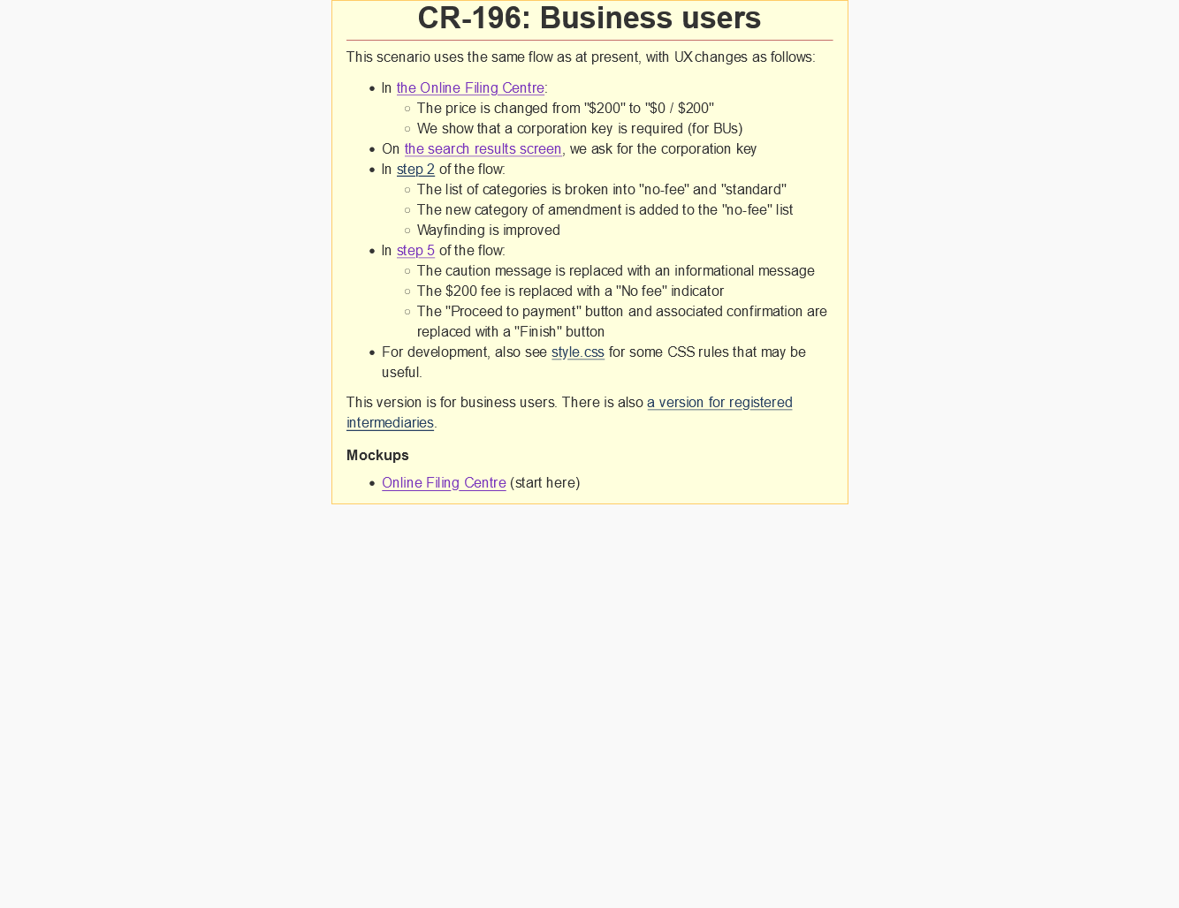
Prototyping at the CIO
At the CIO, they create HTML mockups for testing.
When they hand them to developers, they add yellow boxes explaining points of interest.
Sample page
Sample complete flow

Slide 8
About the Web

Slide 9
What is the Web?
A bunch of files, mostly text files, stored on other people’s computers.
Your web browser (Edge, Chrome, Firefox, Safari, etc.) can do two things:
Render those files in a meaningful way.
Communicate across a network, using HTTP (the hypertext transfer protocol) or HTTPs (a secure form of same), to obtain more files.
Files on the web include:
HTML files (Hypertext markup language)
CSS files (Cascading style sheets)
JS files (JavaScript)
Image files: PNG, GIF, JPEG, SVG, etc.

Slide 10
About HTML (with exercises)

Slide 11
HTML editors
Since HTML is text, you can use any text editor.
Not a word processor! Don’t try to write HTML in Microsoft Word.
Dedicated tools include:
Notepad++
Visual Studio Code
These tools have useful features like code colouring, code linting, and interfaces with GitHub.
General-purpose tools include:
Notepad

Slide 12
A simple HTML file
Copy this code into Notepad, and save it on your desktop as “hello.html”.
Note: Notepad will try to save it as “hello.html.txt” but don’t let it.
<!DOCTYPE html>
<html lang="en">
<head>
<title>
Hello world! - our first web page
</title>
</head>
<body>
<h1>
Hello world!
</h1>
<h2>
About me
</h2>
<p>
Here is a list of famous places I have been:
</p>
<ul>
<li>
Montreal
</li>
<li>
Toronto
</li>
<li>
London (Ontario)
</li>
<li>
The tumbleweed on Hazeldean road
</li>
</ul>
<h2>
About you
</h2>
<label for="your-famous-place">
What is a place that you have been?
</label>
<input type="text" id="your-famous-place">
<button onClick="updateText()">Submit</button>
<p class="noseeum">
Wow you have been to <span id="places"></span>!
</p>
</body>
</html>
The text shows up very small here but in Notepad it will be regular size.

Slide 13
Try it out!
Leave Notepad open, we’re going to use it again.
Look on your desktop, and you should see the file “hello.html”, with an icon.
Double-click it and you will see the web page you’ve made.

Slide 14
URLs
All web pages start as HTML files on a computer somewhere.
They may have other files associated with them e.g. CSS, JavaScript, image files.
We will see how to pull those in.
After pulling them in, the web browser renders them and creates the web page that you see on your screen.
A web browser is able to pull in files from your local computer or from another computer (web server) elsewhere on the World Wide Web.

Slide 15
A second simple HTML file
Now save hello.html as “hello2.html”, and make the following changes:
Change the text between <title> and </title> to read: Hello world 2! - our second web page
Change the text between <h1> and </h1> to read: Hello world 2!
Add the following text somewhere in the document—say, between the </h1> ending tag and the <h2> starting tag. (Tags have to be nested properly.) <p>Please visit <a href="hello.html">our first web page</a>.</p>
Don’t worry about spacing. It is nice to keep it tidy so you can see what you’re doing, but spaces won’t show up when the page is rendered.

Slide 16
Try it out again!
You’ll see hello2.html on your desktop. Double-click it.
It’s probably exactly the same as hello.html. Where are your changes?
Save hello2.html in Notepad.
Now hit the refresh button in your browser.
Click the link. It will bring you to “hello.html”.
Click the back button on your browser. It will bring you back to “hello2.html”.
You could also link to a web URL.

Slide 17
Let’s add an image
First a note. You can’t just copy images off the web, that’s a copyright violation. Either find a licence-free image or make your own.
For a list of image sources, see the Images tab in our Tools Software and Hardware wiki.
You can either use an image locally on your computer or link to a licence-free image on the Web.
In hello2.html, before the </html> end tag, add the following text: <p><img src="https://images.unsplash.com/photo-1550348579-959785e820f7" alt="a goat" width="200px" class="noseeum"></p>
Save your file and refresh your browser.

Slide 18
Stylin’ it up
You can modify many characteristics about how things look on your web page. Let’s create a CSS (Cascading Style Sheets) file.
In Notepad, hit New Window, and create a new file, also on your desktop, named “style.css”. (It actually doesn’t matter what you call it; this is just a common convention.)
Add the following text:
body {
font-family: Calibri;
}
h1 {
color: red;
}
.noseeum {
visibility: hidden;
}
Save the file.

Slide 19
Connecting HTML with CSS
Refresh your file “hello2.html” in the browser. There should be no change.
Now open it again in Notepad. (You may still have it open.)
Before the </head> end tag, add the following text: <link rel="stylesheet" href="style.css">
Save the file and refresh your browser window. You should see the changes now.
Notice that the parts of your page that had the attribute “class=noseeum” have disappeared.
Next step: make them show up based on user interaction.

Slide 20
The name’s script. JavaScript.
Like you did with the CSS file, open a new window in Notepad.
Save this new blank file as “script.js”. Again, this is just a naming convention.
Add the following text:
function updateText() {
let yourPlace = document.getElementById("your-famous-place").value;
document.getElementById("places").innerText = yourPlace;
for (let hiddenText of document.getElementsByClassName("noseeum")) {
hiddenText.style.visibility="visible";
}
}
Save the file.

Slide 21
Connecting HTML with JavaScript
Open hello2.html, and between the <link> tag and the </head> closing tag, add the following text: <script src="script.js"></script>
Save the file in Notepad, refresh your web browser, and try it out.
Enter a place name in the input box and press Submit.
Now you know the basics of creating an interactive HTML prototype.
Next step: make it look like a Canada.ca page.
But first: what is Canada.ca?

Slide 22
How we web at GC
Canada.ca (technology)
Canada.ca (design)
WET
GCWeb theme
CDTS

Slide 23
Canada.ca (technology)
Owner: “Principal Publisher”, Service Canada
This is a role, currently held by ESDC’s Digital Services Directorate
Managed Web Service
A content management system (CMS) named Adobe Experience Manager
Intended to host all GoC content
At ISED we use Drupal
Notes:
http://www.gcpedia.gc.ca/wiki/About_the_Principal_Publisher

Slide 24
Canada.ca (design)
Canada.ca design system.
Owner: Digital Transformation Office, TBS
Mandated by the Directive on the Management of Communications.
Latest in a series of government-wide standard designs.
Notes:
Treasury Board of Canada Secretariat
Strategic Communications and Ministerial Affairs sector
Digital Transformation Office
http://www.gcpedia.gc.ca/wiki/TBS_Digital_Transformation_Office

Slide 25
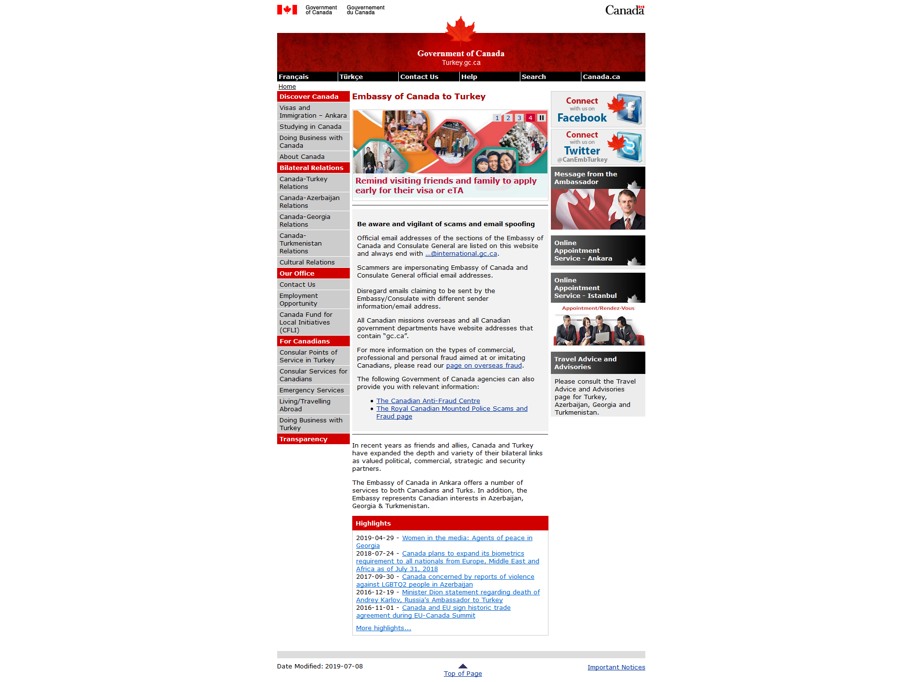
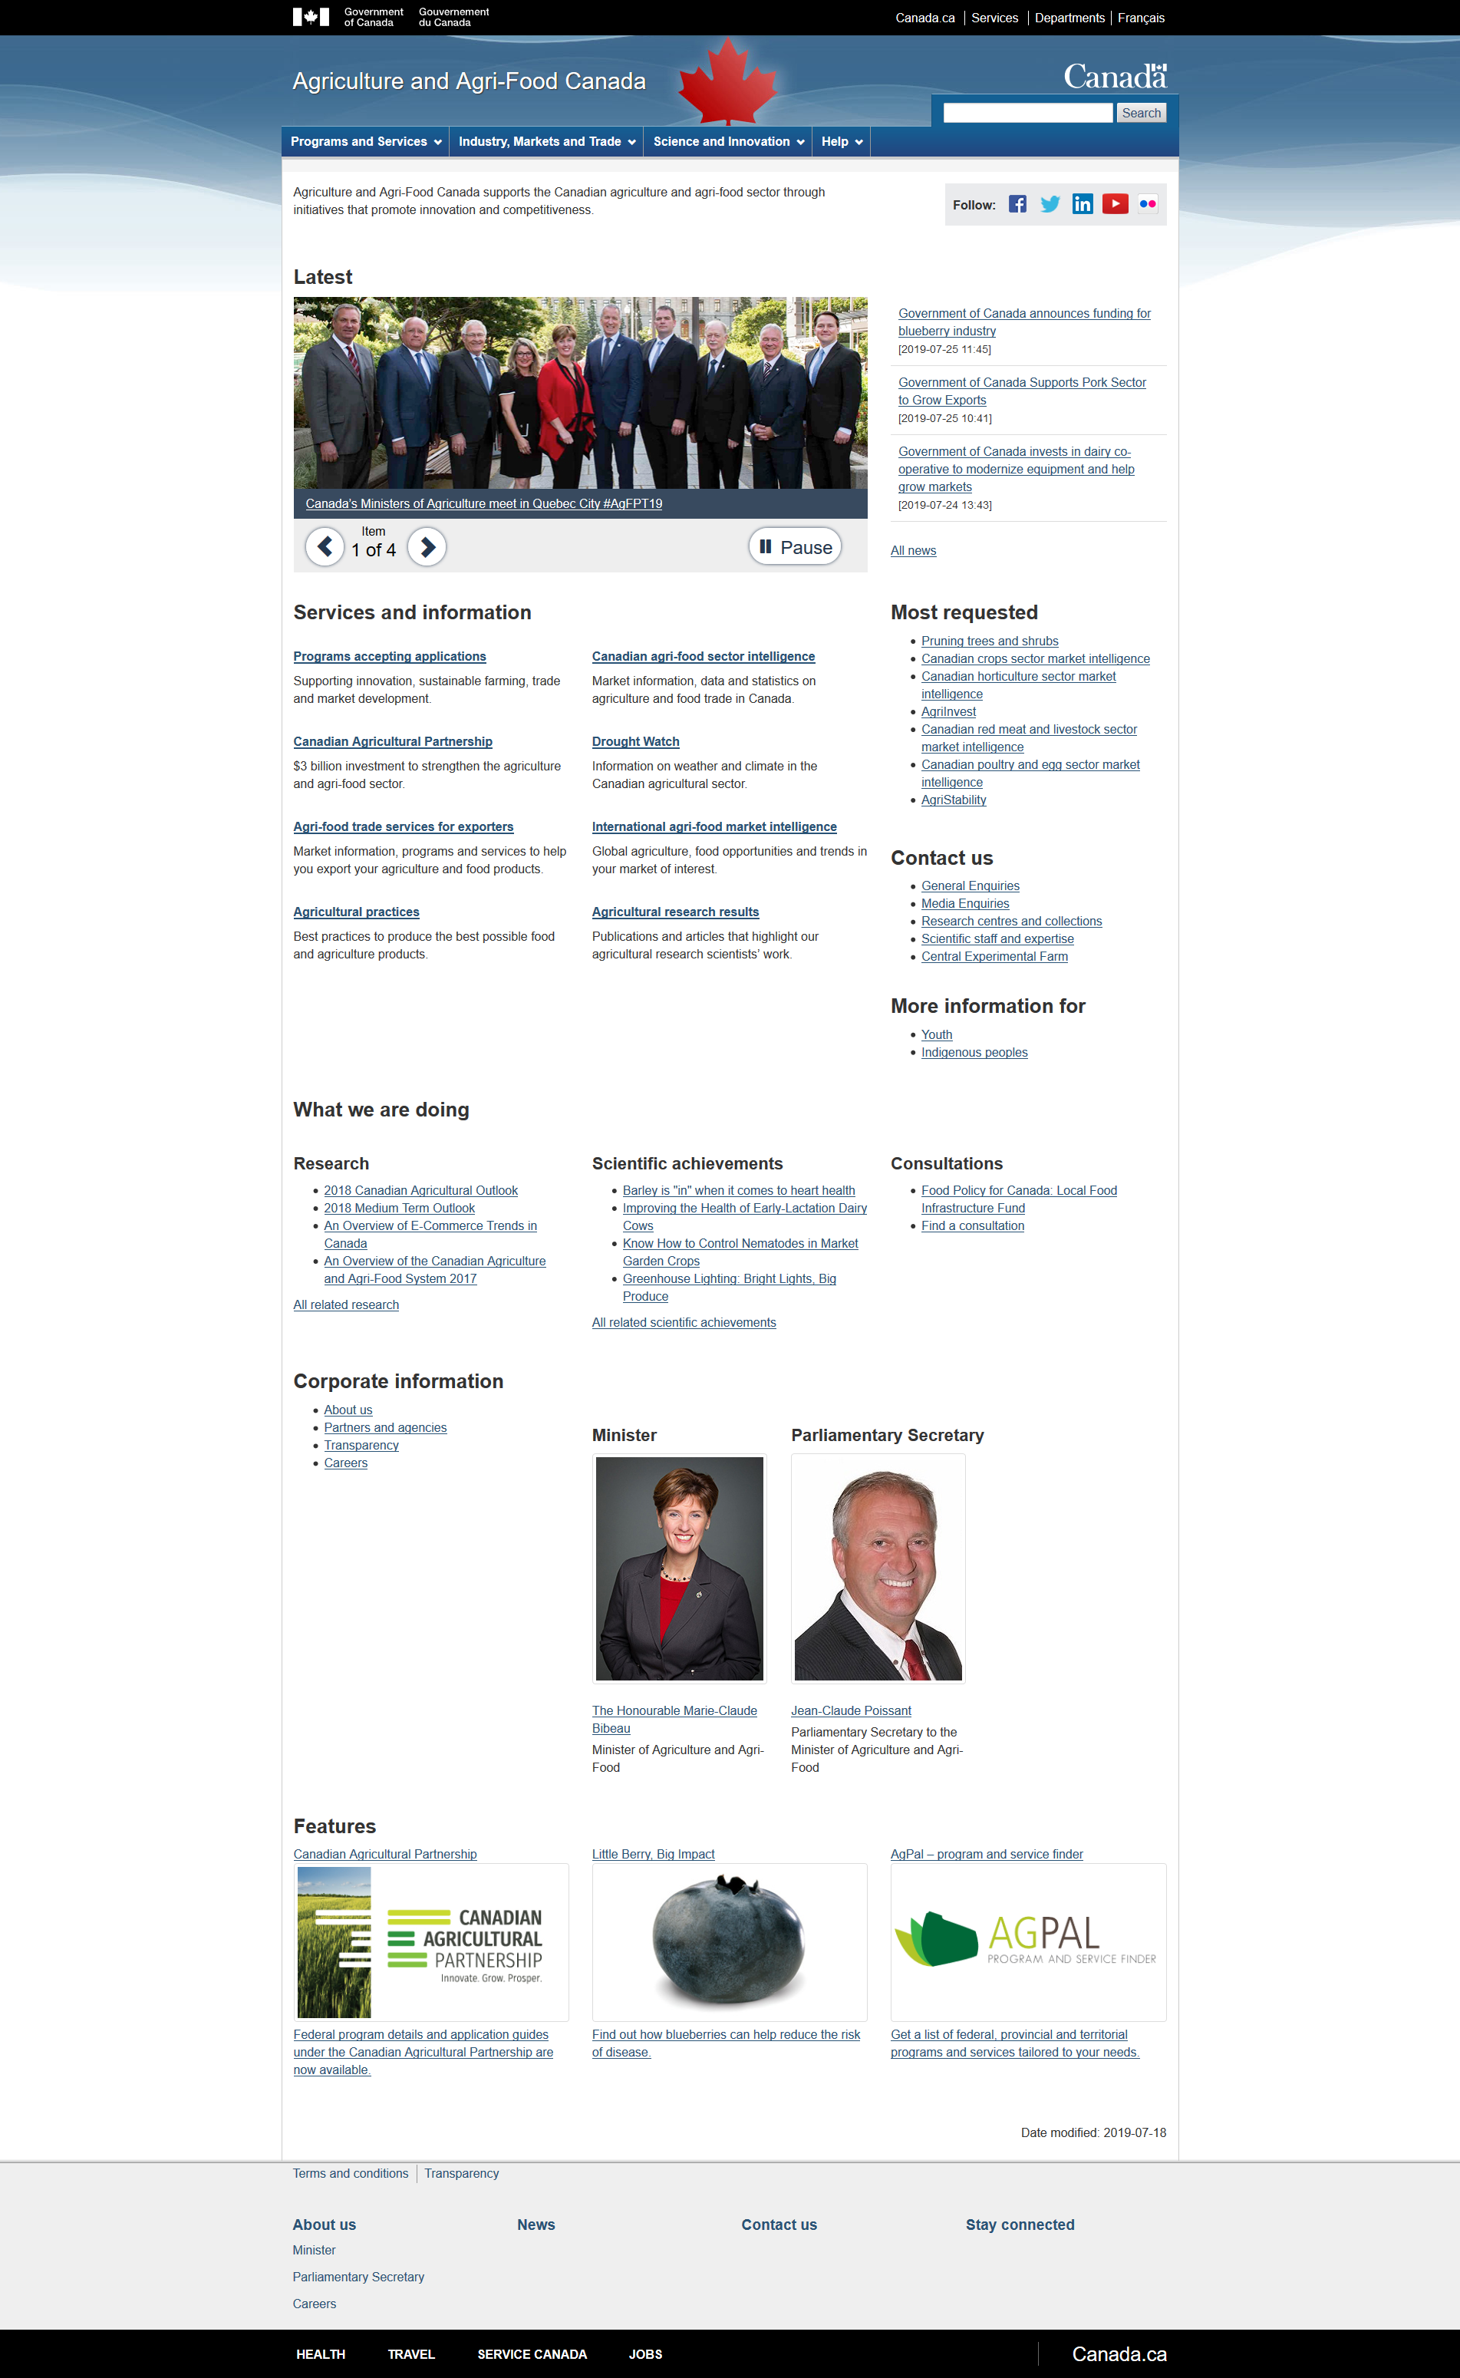
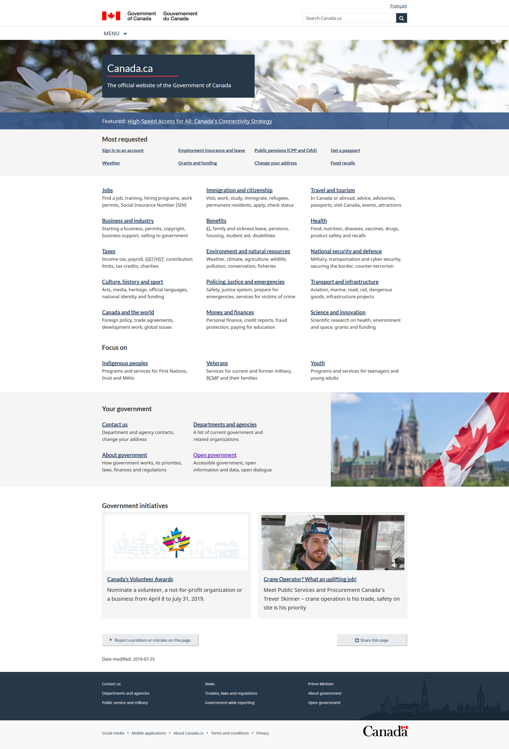
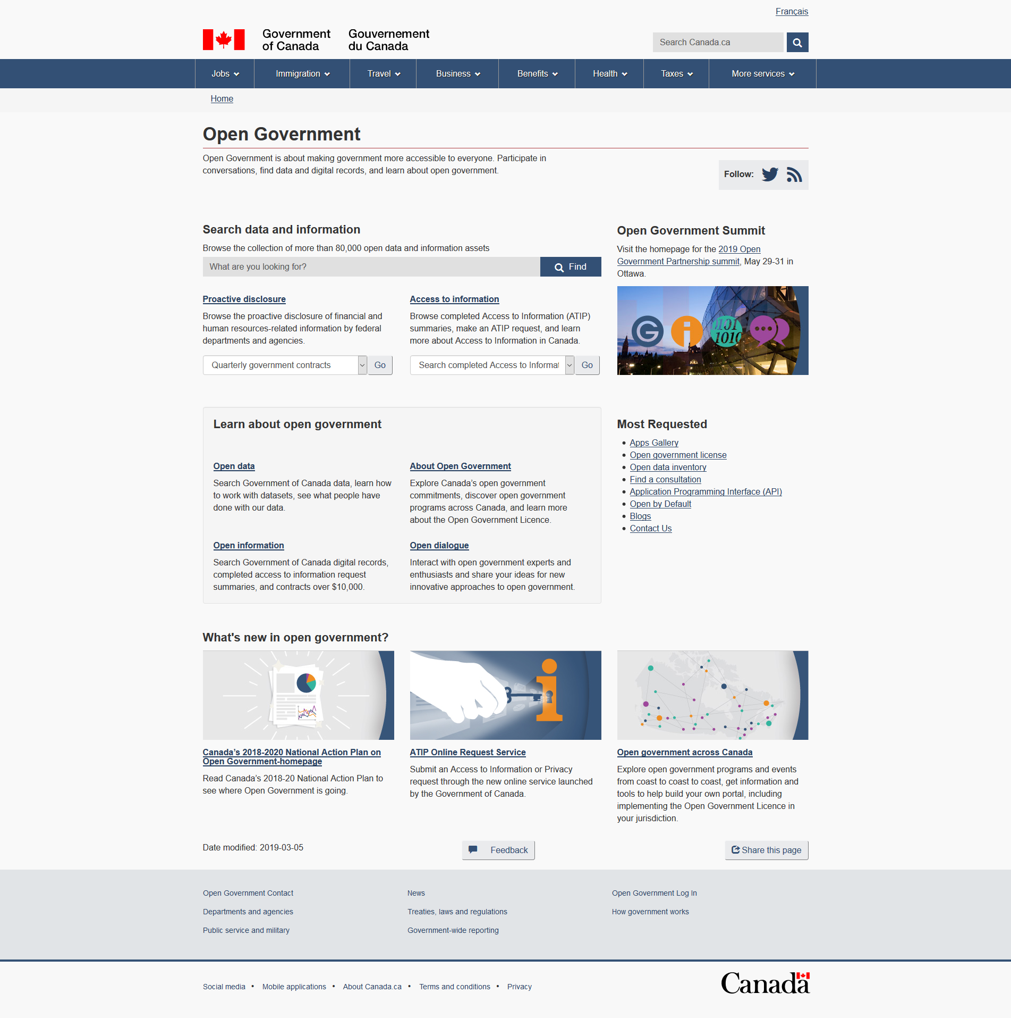
Government-wide standard designs
Usability theme
GCWeb 5
CLF2
GCWeb 4
Notes:
CLF2: http://turkey.gc.ca
Usability Theme: www.agr.gc.ca/
GCWeb 4: https://open.canada.ca/en
GCWeb 5 (January 2019): https://www.canada.ca
As presented at http://www.gcpedia.gc.ca/wiki/Canada.ca_spring_update_to_departments_June_18,_2019

Slide 26
WET
Web Experience Toolkit
Also sometimes called WxT (easier to Google)
“A collaborative open source project led by the Government of Canada”
i.e. Principal Publisher
Three-person team plus about twenty volunteers
Currently version 4
Uses old version of Bootstrap: makes all pages look the same.
Version 5 under development since 2018.
Notes:
https://github.com/wet-boew/GCWeb

Slide 27
GCWeb theme
Collection of page templates, CSS, etc.
Implements the Canada.ca design system.
Until January 2019, had same version number as WET itself.
Currently on v11.0 (as of May 19, 2022), owing to ongoing changes in Canada.ca design system.

Slide 28
CDTS
Centrally Deployed Templates Solution
Developed by ESDC and published to all
Automatic distribution of GCWeb theme
Installed by default on the Managed Web Service
Notes:
http://www.gcpedia.gc.ca/wiki/Centrally_Deployed_Templates_Solution_(CDTS)

Slide 29
Making your page look like Canada.ca

Slide 30
@@
Templates at CIO
• https://asbscr.ic.gc.ca/mockups/ccdev-corp-corpcan-development/UI_Design/wet4/externalWeb/cr196-noFeeAmendment/BU/
Template files that pull in WET
• P:\Documents\base-en.html
P:\Documents\base-fr.html
@@

Slide 31
Getting it online

Slide 32
First check that it’s valid HTML
There are public HTML validators, but don’t use them for pages that you don’t want people to know about. (Doesn’t affect most of our work but still.)
ISED has a locally hosted validator that is available only inside the firewall. It’s at http://asbscr.ic.gc.ca/validator/.
Give it a try. You can upload your “hello2.html” page and make sure it is valid HTML.

Slide 33
Then upload it to a web server
At ISED, we used to have our own publicly facing “hidden” web server, for usability testing. But it was closed off from the Internet in 2021.
Now we can use GitHub pages.
@@
https://github.com/gc-proto/ISED-ISDE
publishes to https://test.canada.ca/ISED-ISDE/
@@

